Slide 1



Order Up Database
Matthew Hickey - Jack MacCallum

Slide 2
Summary
Goal: Create a solution for a restaurant to manage orders that were placed by customers
Features
Managing Tables
Taking orders
Assigning orders to servers
Tracking total cost for payment

Slide 3
Data
The data used came from a Buffalo Wild Wings Menu and Random generation
By using real world data we can show that our system could be used in a restaurant that is already well established

Slide 4
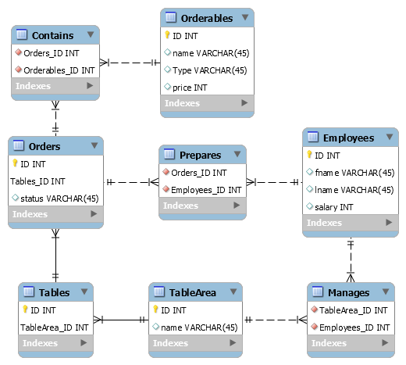
Entity Relationship Diagram

Slide 5
Relational Schema
Orderables(ID, name, type, price)
Contains(Orders_ID, Orderables_ID)
Orders(ID, Tables_ID)
Tables(ID, TableArea_ID)
TableArea(ID, name)
Manages(TableArea_ID, Employees_ID)
Employees(ID, fname, lname, salary)
Prepares(Orders_ID, Employees_ID)

Slide 6
Use Cases
See who manages the Table Areas
Manage Order statuses for each Table
Placing and Adding Items to an Order
Which Orders a Table has
Total Order Price

Slide 7
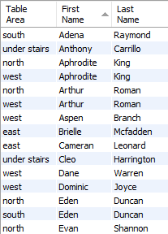
See who manages the Table Areas
One or multiple Employees may manage a Table Area
An Employee may manage zero, one, or multiple Table Areas

Slide 8

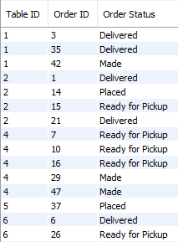
Manage Order statuses for each Table
Tables may have zero, one, or multiple orders
Orders may only have one table

Slide 9
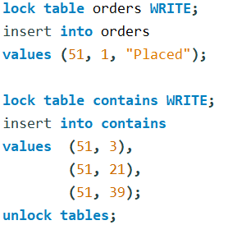
Placing and Adding Items to an Order
When a group of customers initially comes in, an order needs to be created for their table.
Then items need to be added to the order

Slide 10
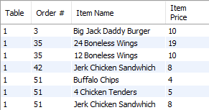




Which Orders a Table has and the Total Price

